Slide 1
ATS Route and Waypoint Implementation:
Shane Sumner
Regional Officer ATM/AIM
ICAO Asia and Pacific Regional Office
8 June 2015

Slide 2
Promulgation Process for ATS Route and Waypoints
Agreement between Administrations
Implementation Date Planning
ATS Route Designator
Waypoint Names (5LNC)
Asia/Pacific Region Basic Air Navigation Plan
Promulgation in State AIP

Slide 3
Agreements between Administrations
Determine route specifications
  Navigational capability required
  Alignment, and spacing from other ATS routes
  Technical details: LSALT, tracks, distances
Industry Consultation
Plan implementation date
  Common implementation date in AIP of all participating administrations
  Aeronautical Information Regulation and Control (AIRAC) date

Slide 4
Implementation Date Planning
  ICAO Doc 9673 - Asia/Pacific Region Basic Air Navigation Plan (BANP)
  Proposal for Amendment (PfA) to the BANP to be approved by ICAO Council
      for any ATS route forming part of the regional network of ATS routes (i.e. ATS routes used by international traffic).
  PfA to BANP should be jointly submitted by proposing States

Slide 5
Implementation Date Planning
  ICAO Doc 9673 - Asia/Pacific Region Basic Air Navigation Plan (BANP)
  Proposing States should allow absolute minimum 8 weeks for approval by Council
    2 – 4 weeks for circulation to ICAO HQ for technical review/comment
    4 weeks (minimum) for circulation to other States and international organizations
    If no objections from States/IOs, usually 2 – 4 weeks for consideration by council
  Historically, PfAs received by Regional Office require re-working before circulation (= one or more more weeks….)

Slide 6
Implementation Date Planning
Promulgation in AIP
  Amendments introducing “Major Changes” in AIP are required to be effective on AIRAC dates.
  Implementation of new ATS routes = “major change”
    ICAO Doc 8126 – Aeronautical Information Services Manual
  AIRAC cycle = 28 days

Slide 7

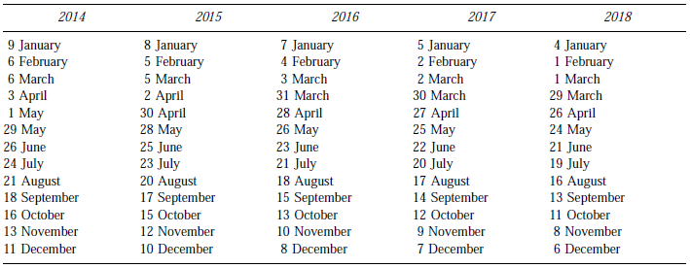
Implementation Date Planning
AIRAC Effective Dates (Doc 8126)

Slide 8
Implementation Date Planning
Promulgation in AIP
  Annex 15 Advance notification requirements
      6.2 Provision of information in paper copy form
6.2.1 Information provided under the AIRAC system in paper copy form shall be distributed by the AIS unit at least 42 days in advance of the effective date with the objective of reaching recipients at least 28 days in advance of the effective date.

Slide 9
Implementation Date Planning
Implementation in AIP
  Annex 15 Advance notification requirements
      6.3 Provision of information as electronic media
6.3.2 Information provided as electronic media, concerning the circumstances listed in Appendix 4, Part 1, shall be distributed/made available by the AIS unit so as to reach recipients at least 28 days in advance of the AIRAC effective date.

Slide 10
Implementation Date Planning
Implementation in AIP
  Annex 15 Advance notification requirement
  Both paper copy form and electronic media:
6.X.X Recommendation.— Whenever major changes are planned and where advance notice is desirable and practicable, information provided either in paper copy form or as electronic media should be distributed/made available at least 56 days in advance of the effective date.

Slide 11
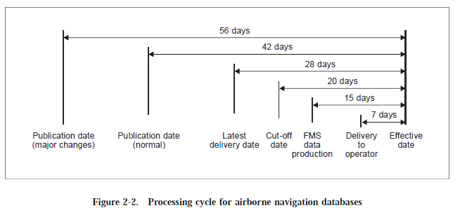
Implementation Date Planning
Promulgation in AIP – why 56 days before effective date?
(ICAO Doc 8126 – AIS Manual)

Slide 12
Implementation Date Planning
Planning Considerations
Implementation Activity | Days
Consultation/Agreement between Administrations (estimated) | (28)
BANP PfA preparation (Administrations, ICAO RO – estimated/historical) | (21)
BANP PfA submission, circulation and ICAO Council approval | 84
Preparation of AIP Amendment (Consult your AIS provider early - estimated) | (14)
Publication of AIP Amendment in advance of effective AIRAC date | 56
Total (estimated) | 203
This is a representative example. Additional days may be required if the PfA is queried/objected by States, IOs or the ICAO Council Fewer days may be required if the PfA is well-prepared, and if AIP amendment preparation is conducted in parallel to PfA processing.

Slide 13
ATS Route Designator
Annex 11 Appendix 1
  3.1.4 States’ requirements for designators shall be notified to the Regional Offices of ICAO for coordination.
  Email request to ICAO Bangkok Office (apac@icao.int)
    Purpose (e.g. new ATS route from X to Y)
    Specify whether RNAV or Non-RNAV
      RNP specification not required when requesting a designator.

Slide 14
Waypoint Names
Annex 11
  3.1 Where a significant point is required at a position not marked by the site of a radio navigation aid, and is used for ATC purposes, it shall be designated by a unique five-letter pronounceable “name-code”. This name-code designator then serves as the name as well as the coded designator of the significant point.
    and
  3.5 States’ requirements for unique five-letter pronounceable name-code designators shall be notified to the Regional Offices of ICAO for coordination.

Slide 15
Waypoint Names
International Codes and Route Designators (ICARD)
  Result of collaborative efforts by EUROCONTROL and the ICAO EUR/NAT Regional Office.
  Now available for all ICAO States.
  Is the sole global source of unique, pronounceable 5-letter name codes (5LNC) marking significant points not associated with a radio-navigation aid.
  Ensures global allocation of 5LNC in compliance with Annex 11.

Slide 16
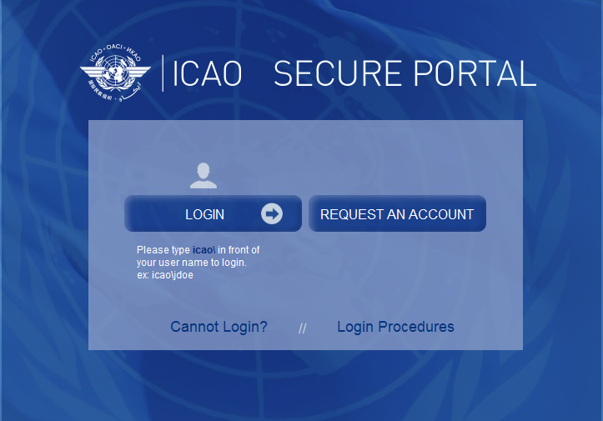
Waypoint Names
International Codes and Route Designators (ICARD)
  Accessible through the ICAO Secure Portal
  Provides the facility for States to notify the Regional Offices of ICAO for coordination of unique five-letter pronounceable name codes (Annex 11).

Slide 17
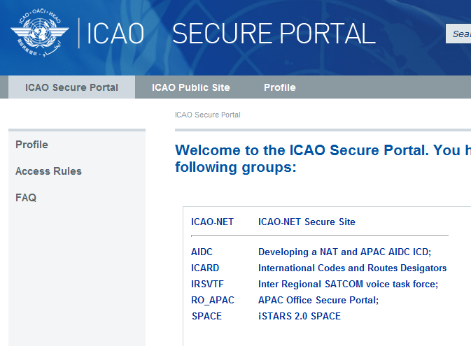
Waypoint Names
International Codes and Route Designators (ICARD)
  Each State must have at least 2 ICARD_5LNC_PLANNERs
  Contact Regional Office for further information
  apac@icao.int

Slide 18
Asia/Pacific Region Basic Air Navigation Plan
ICAO Doc 9673
Vol I – Basic Air Navigation Plan (BANP)
  Includes definition of ATS routes that form part of the regional network of ATS routes.
Vol II – Facilities and Services Implementation Document (FASID)

Slide 19
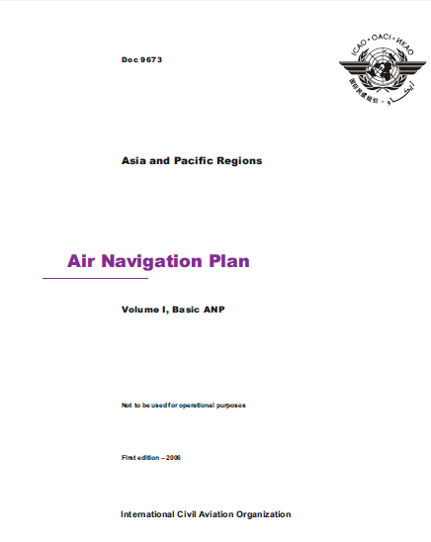
Asia/Pacific Region Basic Air Navigation Plan
ICAO Doc 9673
Accessible through the ICAO Secure Portal
The plan of ATS routes as shown in Table ATS 1 forms the ATS route network for the ASIA/PAC regions.

Slide 20
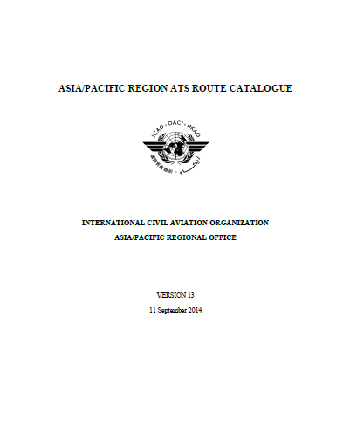
Asia/Pacific Region Basic Air Navigation Plan
Asia/Pacific Region ATS Route Catalogue
Supplements the BANP, providing more up to date information, to develop and maintain the ATS route network in the APAC region
Updated annually by APANPIRG
Available on the Asia/Pacific Regional Office website

Slide 21
BANP ATS Route Amendment Process
Template and Guidance Material
ICAO Asia/Pacific Regional Office website:
http://www.icao.int/apac/Pages/default.aspx

Slide 22
Promulgation in State AIP
After approval of BANP PfA by ICAO Council
Common effective date in AIPs of all affected States
Promulgation in accordance with Annex 15 advance notification requirements
  56 days before effective AIRAC date

